Slide 1

PROFESSIONAL CERTIFICATE
IN MACHINE LEARNING AND
ARTIFICIAL INTELLIGENCE
Office Hour #6 with
Ali Chaudhry
Oct 13, 2023 at 2 pm UTC

Slide 2
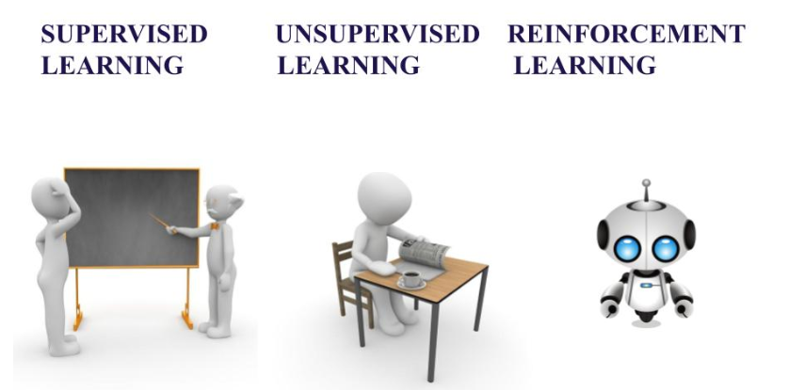
TYPES of AI LEARNING METHODS
If you’re learning a task under supervision, someone is present judging whether you’re getting the right answer. Similarly, in supervised learning, that means having a full set of labeled data while training an algorithm.
Fully labeled means that each example in the training dataset is tagged with the answer the algorithm should come up with on its own.
Clean, perfectly labeled datasets aren’t easy to come by. And sometimes, researchers are asking the algorithm questions they don’t know the answer to. That’s where unsupervised learning comes in.
In unsupervised learning, a deep learning model is handed a dataset without explicit instructions on what to do with it. The training dataset is a collection of examples without a specific desired outcome or correct answer.
It is neither based on supervised learning nor unsupervised learning. Moreover, here the algorithms learn to react to an environment on their own. It is rapidly growing and moreover producing a variety of learning algorithms. These algorithms are useful in the field of Robotics, Gaming etc.
Source: https://www.aitude.com/supervised-vs-unsupervised-vs-reinforcement/

Slide 3
Unsupervised Learning Applications
CLUSTERING
Clustering is a data mining technique which groups unlabeled data based on their similarities or differences. Clustering algorithms are used to process raw, unclassified data objects into groups represented by structures or patterns in the information.
K-means
Gaussian MIxture Model
DIMENSIONAL REDUCTION
While more data generally yields more accurate results, it can also impact the performance of machine learning algorithms (e.g. overfitting) and it can also make it difficult to visualize datasets. Dimensionality reduction is a technique used when the number of features, or dimensions, in a given dataset is too high. It reduces the number of data inputs to a manageable size while also preserving the integrity of the dataset as much as possible. It is commonly used in the preprocessing data stage, and there are a few different dimensionality reduction methods that can be used
Principal Component Analysis
Singular Value Decomposition

Slide 4
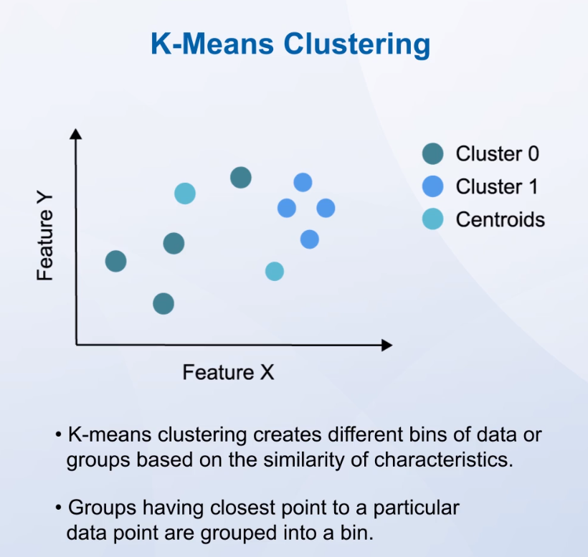
K-Means

Slide 5
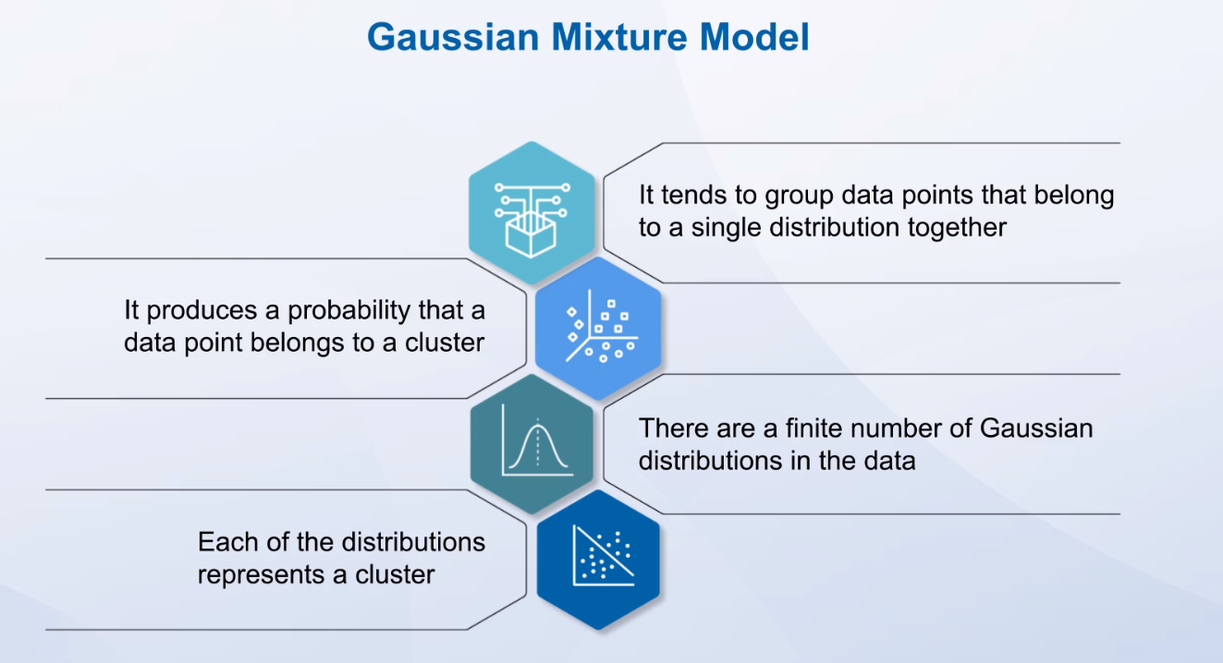
Gaussian Mixture Model

Slide 6
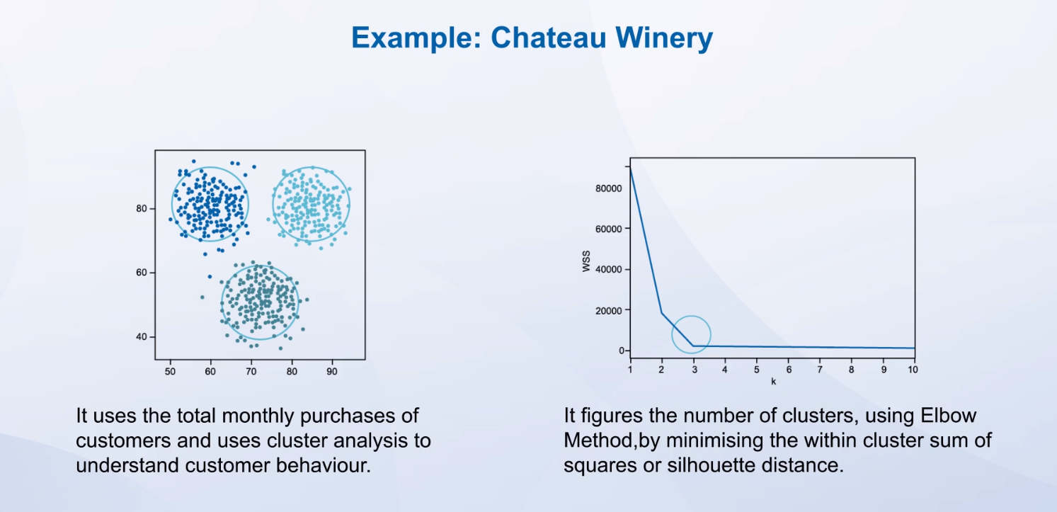
Example

Slide 7
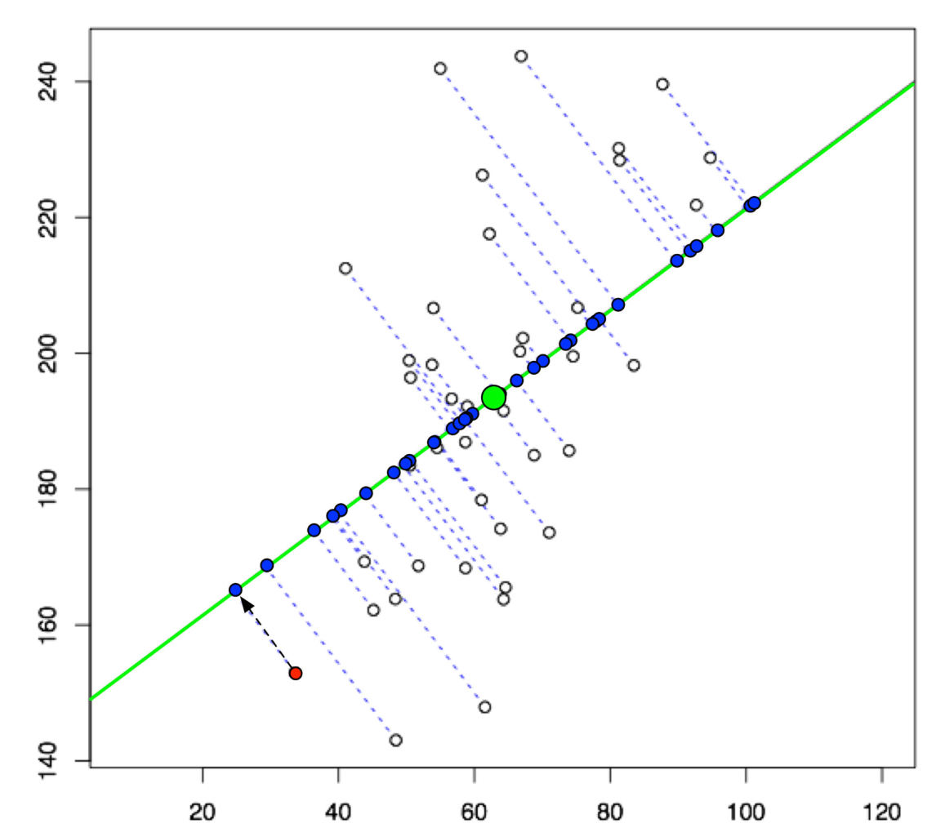
Principal Component Analysis
PCA is a very flexible tool and allows analysis of datasets that may contain, for example, multicollinearity, missing values, categorical data, and imprecise measurements. The goal is to extract the important information from the data and to express this information as a set of summary indices called principal components (orthogonal to each other)
Example in picture:
The green line has been constructed using mathematical optimization to maximize the variance between the data points as much as possible along that line. We call this line our first principal component. Naturally, the points on the line are still closer to each other than in the original 2D space because you are losing a dimension to distinguish them. But in many cases, the simplification achieved by dimensionality reduction outweighs the loss in information, and the loss can be partly or fully reconstructed.

Slide 8

DISCUSSION
Discuss with you team what could be potential applications of Unsupervised Learning
Present the key points of your discussion back to the class
Notes:
IN THE DEPLOYMENT YOU DO THE TRAINING OF THE MACHINE (SUPERVISED LEARNING)

Slide 9
Unsupervised Learning Applications
Clustering
CUSTOMER and MARKET SEGMENTATION
ANOMALY DETECTION (Fraud, maintenance)
HEALTHCARE (diagnose cancer at earlier stage)
Association
PRODUCT RECOMMENDATIONS
TARGETED MARKETING
Notes:
e-commerce websites like Amazon use clustering algorithms to implement a user-specific recommendation system
you have a YouTube channel. You may have a lot of data about the subscribers of your channel. If you want to detect groups of similar subscribers, then you may need to run a clustering algorithm.
you have a YouTube channel. You may have a lot of data about the subscribers of your channel. If you want to detect groups of similar subscribers, then you may need to run a clustering algorithm.

Slide 10
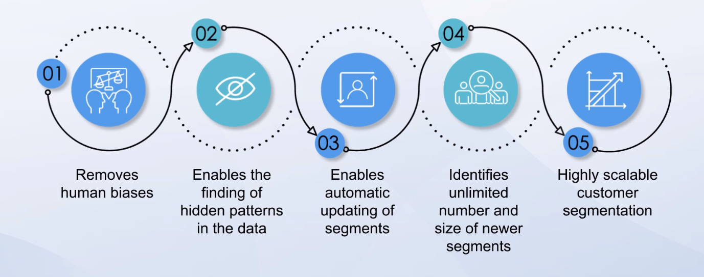
Applications: Segmentation

Slide 11

QUESTIONS?

